Slide 1
ECEG-5193: Algorithm Analysis and Design
Algorithms of Graph Problems
Algorithms for fundamental graph problems

Slide 2
The Shortest Path problem
Given graph and a vertex s find shortest paths from s to all other vertices.
Map routing, robot navigation, urban traffic planning
Optimal pipelining of VLSI chip
Routing of telecommunication messages
Network routing protocols (OSPF, BGP, RIP)
Seam carving, texture mapping, typesetting in TeX!

Slide 3
Variants of Shortest Path
Single-source shortest paths
  G = (V, E) ⇒ find a shortest path from a given source vertex s to each vertex v ∈ V
Single-destination shortest paths
  Find a shortest path to a given destination vertex t from each vertex v
  Reversing the direction of each edge ⇒ single-source
Single-pair shortest path
  Find a shortest path from u to v for given vertices u and v
All-pairs shortest-paths
  Find a shortest path from u to v for every pair of vertices u and v

Slide 4
Shortest path:
The weight of path p =<v₀,v₁,…,v_{k} > is the sum of the weights of its constituent edges:
The cost of the shortest path from s to v is denoted as δ(s, v).

Slide 5
Shortest paths
What is the shortest path from a to d?
B
D
A
C
E

Slide 6
Shortest paths
BFS
B
D
A
C
E

Slide 7
Shortest paths
What is the shortest path from a to d?
2
B
D
3
3
A
1
2
1
C
E
4

Slide 8
Shortest paths
We can still use BFS
2
B
D
3
3
A
1
2
1
C
E
4

Slide 9
Shortest paths
We can still use BFS
2
B
D
B
D
3
3
A
1
2
A
1
C
E
C
E
4

Slide 10
Shortest paths
We can still use BFS
B
D
A
C
E

Slide 11
Shortest paths
What is the problem?
B
D
A
C
E

Slide 12
Shortest paths
Running time is dependent on the weights
B
B
2
100
1
A
50
A
4
C
200
C

Slide 13
Shortest paths
B
B
100
A
50
A
200
C
C

Slide 14
Shortest paths
B
A
C

Slide 15
Shortest paths
B
A
C

Slide 16
Shortest paths
Nothing will change as we expand the frontier until we’ve gone out 100 levels
B
A
C

Slide 17
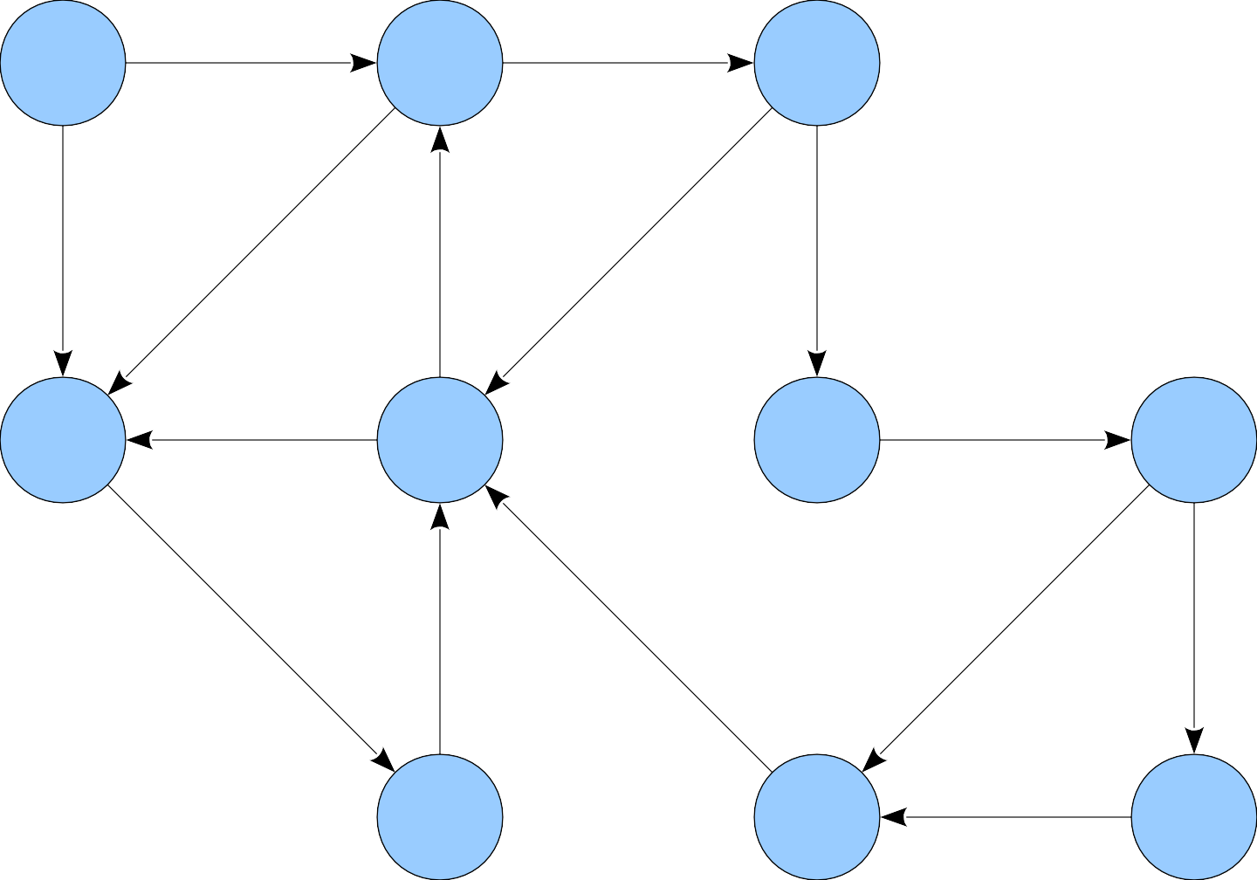
5
3
0
1
3
9
-7
2
1
3
-4
0
-6
-1
1

Slide 18

5
3
★
0
1
3
9
-7
2
1
■
3
-4
0
-6
-1
1

Slide 19
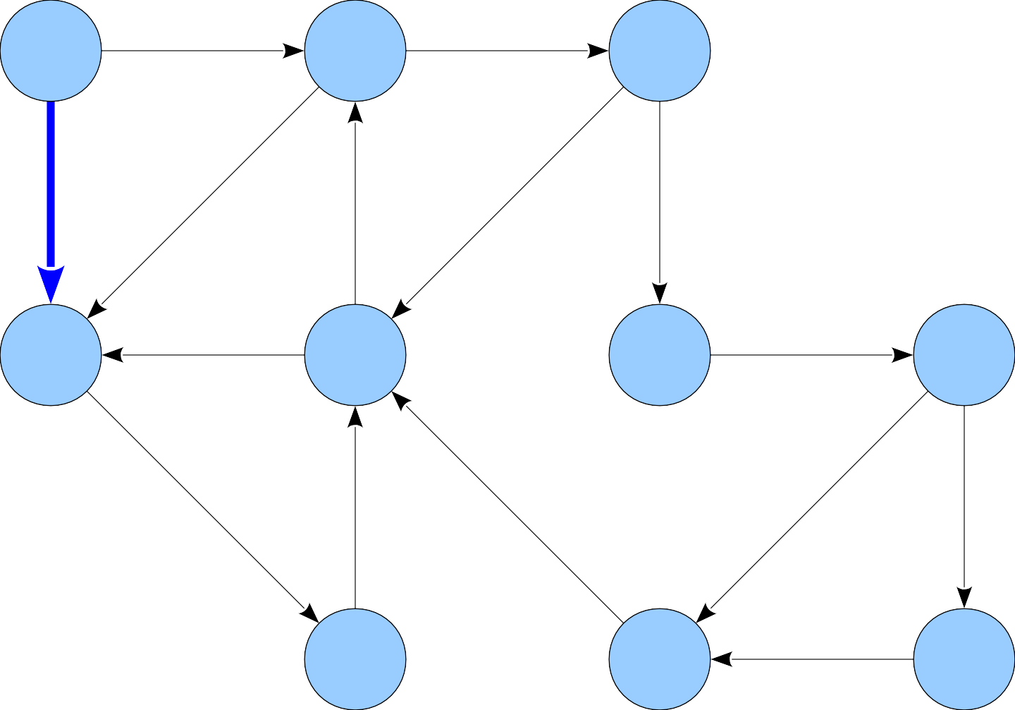
5
3
★
0
1
3
9
-7
2
1
■
3
-4
0
-6
-1
1

Slide 20
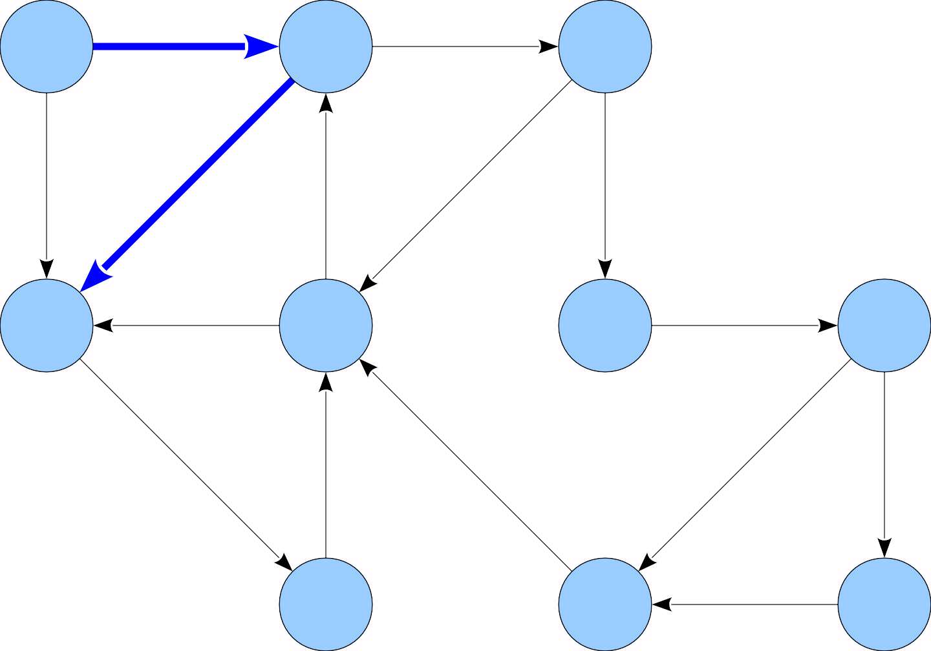
5
3
★
0
1
3
9
-7
2
1
■
3
-4
0
-6
-1
1

Slide 21
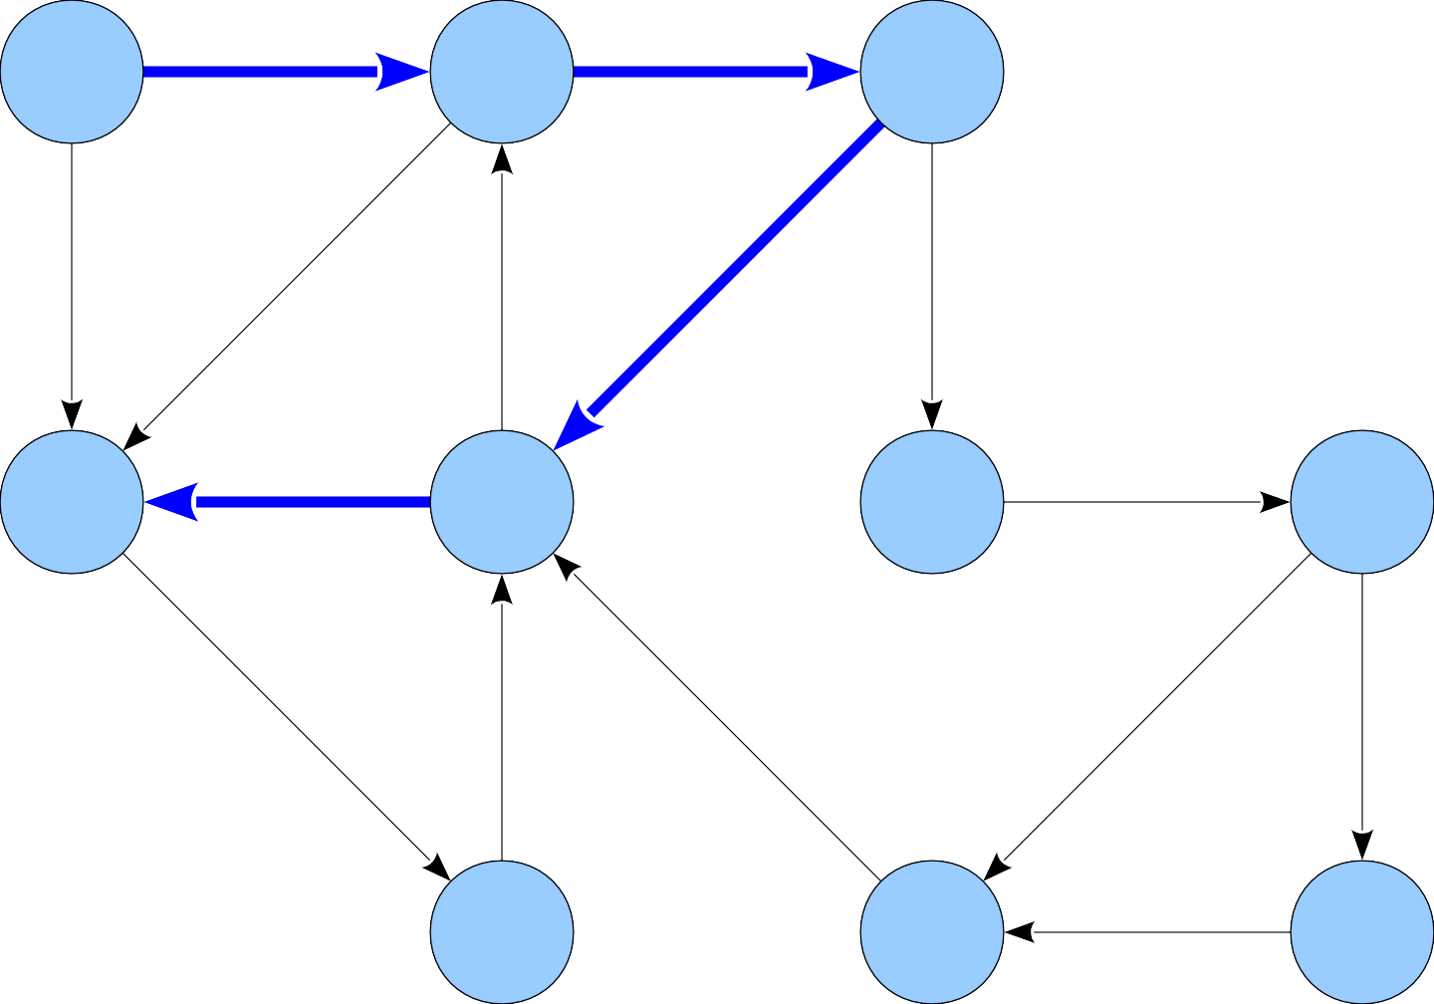
5
3
★
0
1
3
9
-7
2
1
■
1
3
-4
0
-6
-1
1

Slide 22
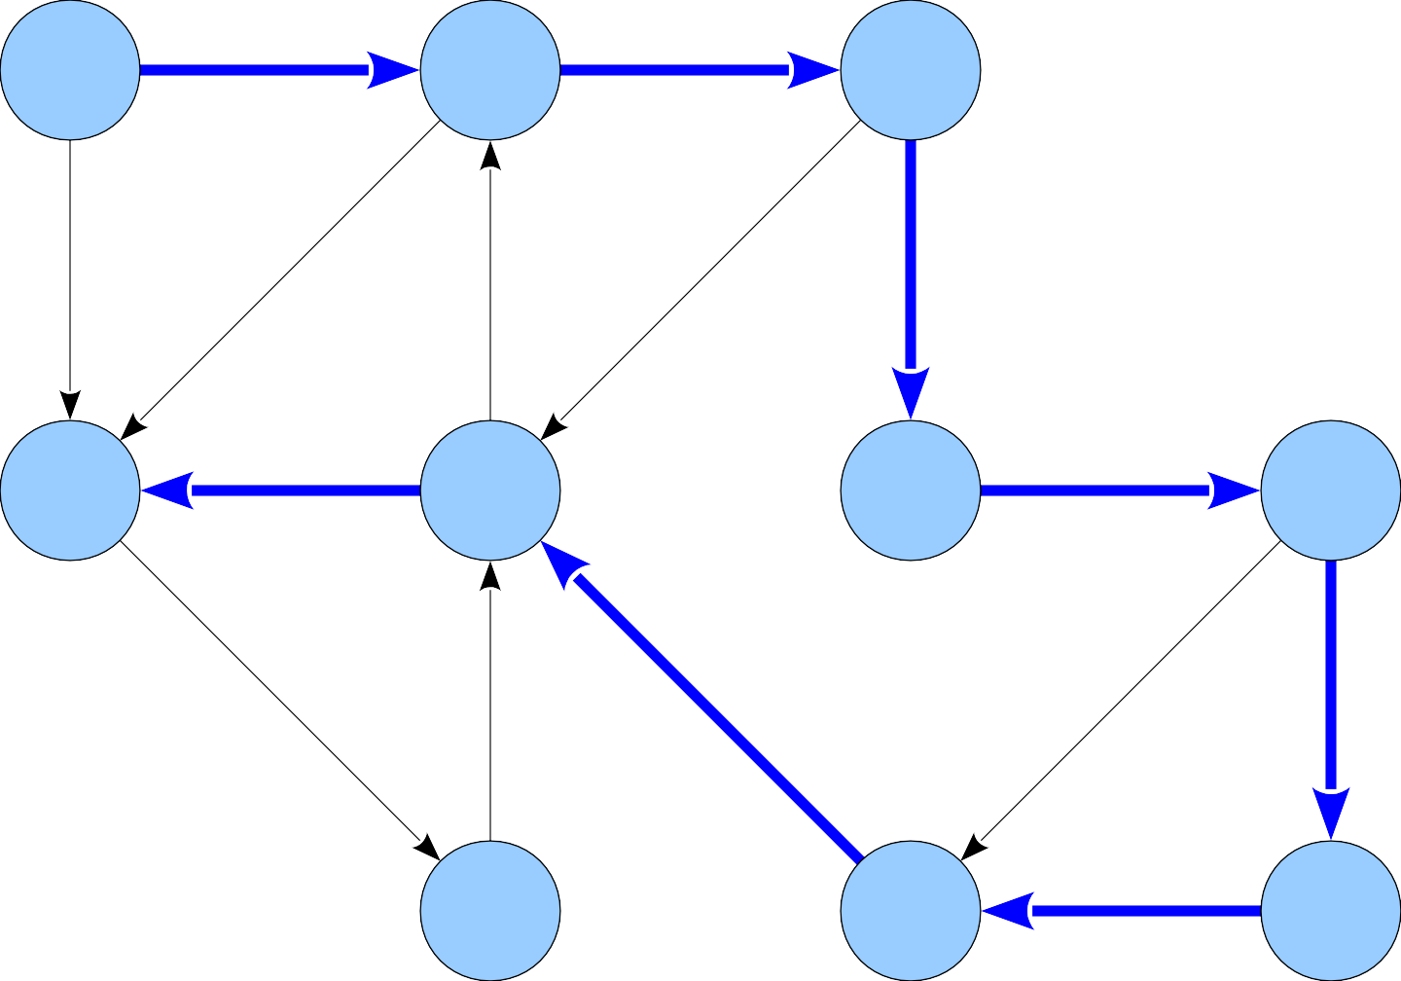
5
3
★
0
1
3
9
-7
2
1
■
3
-4
0
-6
-1
1

Slide 23
A Different Intuition

Slide 24
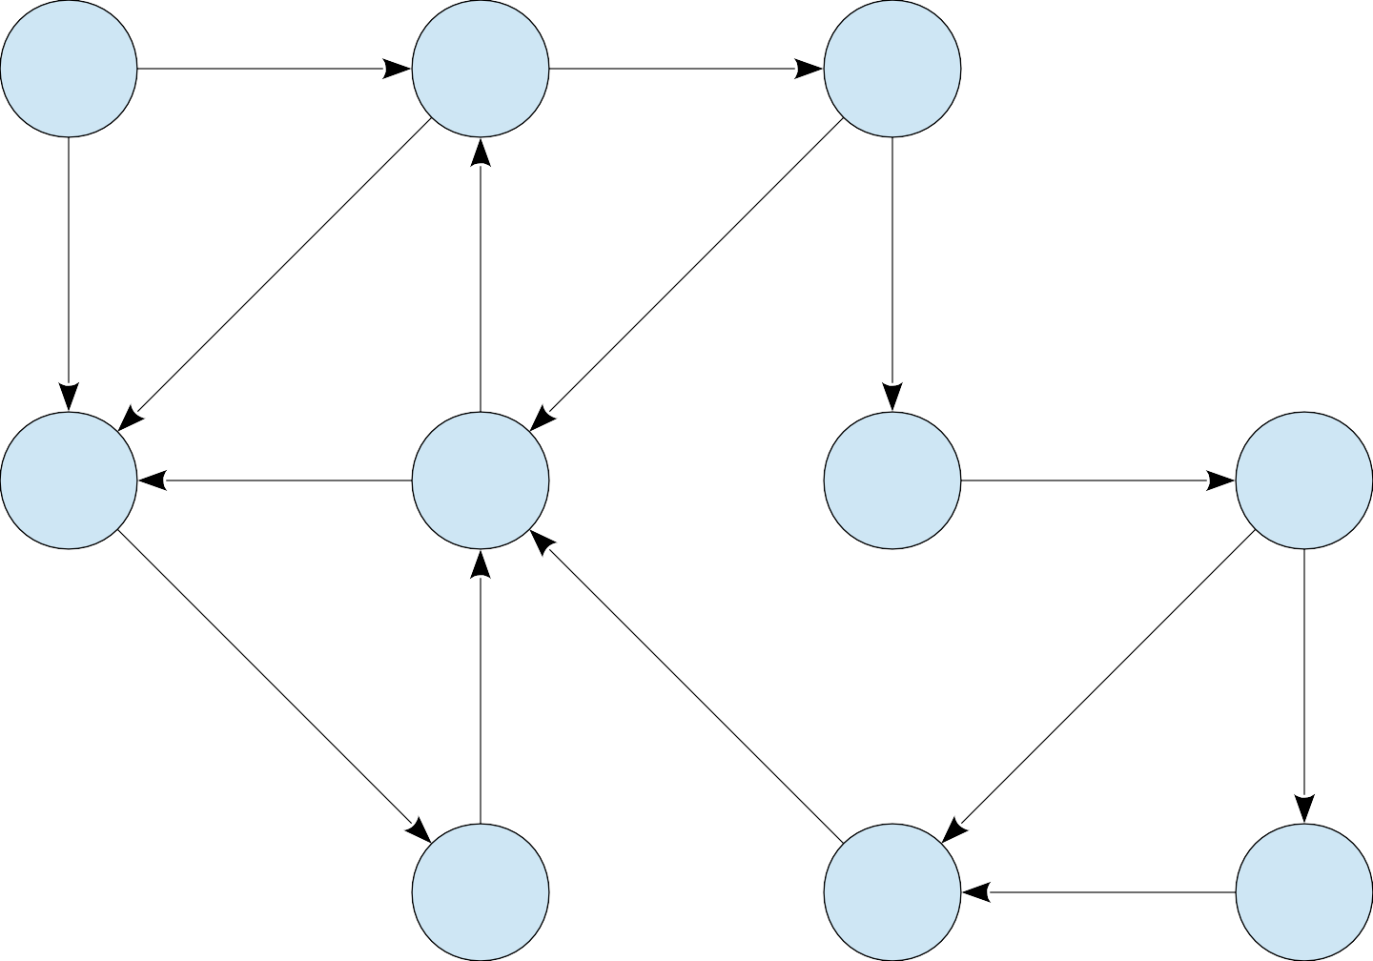
5
3
0
1
3
9
-7
2
1
3
-4
0
-6
-1
1

Slide 25
5
3
0
1
3
9
-7
2
1
3
-4
0
-6
-1
1
Consider paths of length 0.

Slide 26
0
5
3
0
1
3
9
-7
2
1
3
-4
0
-6
-1
1
Consider paths of length 0.

Slide 27
0
5
∞
3
∞
0
1
3
9
-7
2
∞
1
∞
∞
∞
3
-4
0
-6
-1
∞
∞
1
∞
Consider paths of length 0.

Slide 28
0
5
∞
3
∞
0
1
3
9
-7
2
∞
1
∞
∞
∞
3
-4
0
-6
-1
∞
∞
1
∞
Consider paths of length 1.

Slide 29
0
5
5
3
∞
0
1
3
9
-7
2
∞
1
∞
∞
∞
3
-4
0
-6
-1
∞
∞
1
∞
Consider paths of length 1.

Slide 30
0
5
5
3
∞
0
1
3
9
-7
2
3
1
∞
∞
∞
3
-4
0
-6
-1
∞
∞
1
∞
Consider paths of length 1.

Slide 31
0
5
5
3
∞
0
1
3
9
-7
2
3
1
∞
∞
∞
3
-4
0
-6
-1
∞
∞
1
∞
Consider paths of length 2.

Slide 32
0
5
5
3
8
0
1
3
9
-7
2
3
1
∞
∞
∞
3
-4
0
-6
-1
∞
∞
1
∞
Consider paths of length 2.

Slide 33
0
5
5
3
8
0
1
3
9
-7
2
3
1
∞
∞
∞
3
-4
0
-6
-1
2
∞
1
∞
Consider paths of length 2.

Slide 34
0
5
5
3
8
0
1
3
9
-7
2
3
1
∞
∞
∞
3
-4
0
-6
-1
2
∞
1
∞
Consider paths of length 3.

Slide 35
0
5
5
3
8
0
1
3
9
-7
2
3
1
2
1
∞
3
-4
0
-6
-1
2
∞
1
∞
Consider paths of length 3.

Slide 36
0
5
5
3
8
0
1
3
9
-7
2
3
1
2
1
∞
3
-4
0
-6
-1
2
∞
1
∞
Consider paths of length 4.

Slide 37
0
5
5
3
8
0
1
3
9
-7
2
3
1
2
1
3
3
-4
0
-6
-1
2
∞
1
∞
Consider paths of length 4.

Slide 38
0
5
5
3
8
0
1
3
9
-7
2
3
1
2
1
3
3
-4
0
-6
-1
2
∞
1
∞
Consider paths of length 5.

Slide 39
0
5
5
3
8
0
1
3
9
-7
2
3
1
2
1
3
3
-4
0
-6
-1
2
-1
1
-3
Consider paths of length 5.

Slide 40
0
5
5
3
8
0
1
3
9
-7
2
3
1
2
1
3
3
-4
0
-6
-1
2
-1
1
-3
Consider paths of length 6.

Slide 41
0
5
5
3
8
0
1
3
9
-7
2
3
1
2
1
3
3
-4
0
-6
-1
2
-2
1
-3
Consider paths of length 6.

Slide 42
0
5
5
3
8
0
1
3
9
-7
2
3
1
2
1
3
3
-4
0
-6
-1
2
-2
1
-3
Consider paths of length 7.

Slide 43
0
5
5
3
8
0
1
3
9
-7
2
3
1
1
1
3
3
-4
0
-6
-1
2
-2
1
-3
Consider paths of length 7.

Slide 44
0
5
5
3
8
0
1
3
9
-7
2
3
1
1
1
3
3
-4
0
-6
-1
2
-2
1
-3
Consider paths of length 8.

Slide 45
0
5
5
3
8
0
1
3
9
-7
2
2
1
1
1
3
3
-4
0
-6
-1
2
-2
1
-3
Consider paths of length 8.

Slide 46
0
5
5
3
8
0
1
3
9
-7
2
2
1
1
1
3
3
-4
0
-6
-1
2
-2
1
-3
Consider paths of length 9.

Slide 47
0
5
5
3
8
0
1
3
9
-7
2
2
1
1
1
3
3
-4
0
-6
-1
1
-2
1
-3
Consider paths of length 9.

Slide 48
0
5
5
3
8
0
1
3
9
-7
2
2
1
1
1
3
3
-4
0
-6
-1
1
-2
1
-3
Consider paths of length 10+.

Slide 49
Single source shortest paths
Dijkstra’s Algorithm

Slide 50


Slide 51
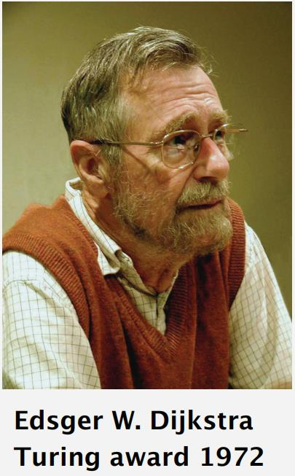
Edsger W. Dijkstra: Select Quotes
“Do only what only you can do.”
“The use of COBOL cripples the mind; its teaching should, therefore, be regarded as a criminal offence.”
“It is practically impossible to teach good programming to students that have had a prior exposure to BASIC: as potential programmers they are mentally mutilated beyond hope of regeneration.”

Slide 52
Dijkstra’s algorithm
Solves the single-source shortest-paths problem on a weighted, directed graph G = (V, E)
  we assume that w(u, v) ≥ 0 for each edge (u, v) ∈ E.
Maintains a set S of vertices whose final shortest-path weights from the source s have already been determined.
Repeatedly selects the vertex u ∈ V - S with the minimum shortest-path estimate, adds u to S, and relaxes all edges leaving u.
We can use a min-priority queue Q of vertices, keyed by their d values

Slide 53
Dijkstra’s algorithm
The algorithm proceeds in stages.
At each stage, the algorithm
  selects a vertex v, which has the smallest distance D_{v} among all the unknown vertices, and
  declares that the shortest path from s to v is known.
  then for the adjacent nodes of v (which are denoted as w) D_{w} is updated with new distance information
How do we change D_{w}?
  If its current value is larger than D_{v} + C_{v,w} we change it.

Slide 54
Dijkstra’s algorithm
DIJKSTRA(G, w, s)
1
2
3
4
5
6
7
8
INITIALIZE-SINGLE-SOURCE(G, s)
S = φ
Q = G.V
while Q≠φ
u = EXTRACT-MIN(Q)
S = S ∪ { u }
for each vertex v ∈ G.Adj[u]
RELAX(u, v, w)

Slide 55
Relaxation
The process of relaxing an edge (u,v) consists of testing whether we can improve the shortest path to v found so far by going through u and, if so, updating d[v].
relax(u, v)
if d[v] > d[u]+w(u,v) then
d[v] ← d[u]+w(u,v)
π[v] ← u

Slide 56
u
v
u
v
2
2
5
9
5
6
RELAX(u,v)
RELAX(u,v)
u
v
u
v
2
2
5
7
5
6
(a)
(b)
a) Because d[v] > d[u] + w(u, v) prior to relaxation, the value of d[v] decreases.
b) Here, d[v] ≤ d[u] + w(u, v) before the relaxation step, so d[v] is unchanged by relaxation.

Slide 57
u
v
1
8
8
10
9
s
0
2
3
4
6
7
5
8
8
2
x
y
(a)
Notes:
Single Source Shortest Path Problem

Slide 58
u
v
1
10/s
8
10
9
s
0
2
3
4
6
7
5
5/s
8
2
x
y
(b)
(s,x) is the shortest path using one edge. It is also the shortest path from s to x.

Slide 59
u
v
1
8/x
14/x
10
9
s
0
2
3
4
6
7
5
5/s
7/x
2
x
y
(c)

Slide 60
u
v
1
8/x
13/y
10
9
s
0
2
3
4
6
7
5
5/s
7/x
2
x
y
(d)

Slide 61
u
v
1
8/x
9/u
10
9
s
0
2
3
4
6
7
5
5/s
7/x
2
x
y
(e)

Slide 62
u
v
1
8/x
9/u
10
9
s
0
2
3
4
6
7
5
5/s
7/x
2
x
y
(f)
Backtracking: v-u-x-s

Slide 63
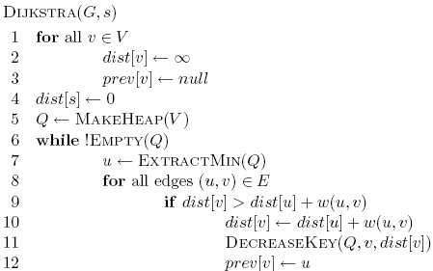
Dijkstra’s algorithm

Slide 64
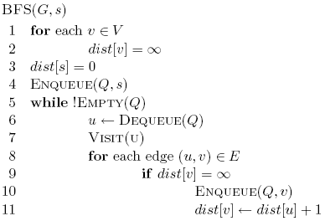
Dijkstra’s algorithm

Slide 65
Dijkstra’s algorithm
prev keeps track of
the shortest path

Slide 66
Dijkstra’s algorithm

Slide 67
Dijkstra’s algorithm

Slide 68
Dijkstra’s algorithm

Slide 69
3
B
D
3
1
A
1
2
1
C
E
4

Slide 70
∞
∞
3
B
D
3
∞
1
A
1
2
∞
1
C
E
∞
4

Slide 71
Heap
A 0
B ∞
C ∞
D ∞
E ∞
∞
∞
3
B
D
3
0
1
A
1
2
∞
1
C
E
∞
4

Slide 72
Heap
B ∞
C ∞
D ∞
E ∞
∞
∞
3
B
D
3
0
1
A
1
2
∞
1
C
E
∞
4

Slide 73
Heap
B ∞
C ∞
D ∞
E ∞
∞
∞
3
B
D
3
0
1
A
1
2
∞
1
C
E
∞
4

Slide 74
Heap
C 1
B ∞
D ∞
E ∞
∞
∞
3
B
D
3
0
1
A
1
2
1
1
C
E
∞
4

Slide 75
Heap
C 1
B ∞
D ∞
E ∞
∞
∞
3
B
D
3
0
1
A
1
2
1
1
C
E
∞
4

Slide 76
Heap
C 1
B 3
D ∞
E ∞
3
∞
3
B
D
3
0
1
A
1
2
1
1
C
E
∞
4

Slide 77
Heap
C 1
B 3
D ∞
E ∞
3
∞
3
B
D
3
0
1
A
1
2
1
1
C
E
∞
4

Slide 78
Heap
B 3
D ∞
E ∞
3
∞
3
B
D
3
0
1
A
1
2
1
1
C
E
∞
4

Slide 79
Heap
B 3
D ∞
E ∞
3
∞
3
B
D
3
0
1
A
1
2
1
1
C
E
∞
4

Slide 80
Heap
B 3
D ∞
E ∞
3
∞
3
B
D
3
0
1
A
1
2
1
1
C
E
∞
4

Slide 81
Heap
B 2
D ∞
E ∞
2
∞
3
B
D
3
0
1
A
1
2
1
1
C
E
∞
4

Slide 82
Heap
B 2
D ∞
E ∞
2
∞
3
B
D
3
0
1
A
1
2
1
1
C
E
∞
4

Slide 83
Heap
B 2
E 5
D ∞
2
∞
3
B
D
3
0
1
A
1
2
1
1
C
E
5
4

Slide 84
Heap
B 2
E 5
D ∞
2
∞
3
B
D
3
0
1
A
1
2
1
1
C
E
5
4

Slide 85
Heap
B 2
E 5
D ∞
2
∞
3
B
D
3
0
All nodes reachable from starting node within a given distance
1
A
1
2
1
1
C
E
5
4

Slide 86
Heap
E 3
D 5
2
5
3
B
D
3
0
1
A
1
2
1
1
C
E
3
4

Slide 87
Heap
D 5
2
5
3
B
D
3
0
1
A
1
2
1
1
C
E
3
4

Slide 88
Heap
2
5
3
B
D
3
0
1
A
1
2
1
1
C
E
3
4

Slide 89
Heap
2
5
3
B
D
0
1
A
1
1
1
C
E
3

Slide 90
Is Dijkstra’s algorithm correct?
Invariant:

Slide 91
Is Dijkstra’s algorithm correct?
Invariant: For every vertex removed from the heap, dist[v] is the actual shortest distance from s to v

Slide 92
Is Dijkstra’s algorithm correct?
Invariant: For every vertex removed from the heap, dist[v] is the actual shortest distance from s to v
  The only time a vertex gets visited is when the distance from s to that vertex is smaller than the distance to any remaining vertex
  Therefore, there cannot be any other path that hasn’t been visited already that would result in a shorter path

Slide 93
Running time?

Slide 94
Running time?
1 call to MakeHeap

Slide 95
Running time?
|V| iterations

Slide 96
Running time?
|V| calls

Slide 97
Running time?
O(|E|) calls

Slide 98
Running time?
Depends on the heap implementation
1 MakeHeap
|V| ExtractMin
|E| DecreaseKey
Total
Array
O(|V|)
O(|V|²)
O(|E|)
O(|V|²)
Bin heap
O(|V|)
O(|V| log |V|)
O(|E| log |V|)
O((|V|+|E|) log |V|)
O(|E| log |V|)

Slide 99
Running time?
Depends on the heap implementation
1 MakeHeap
|V| ExtractMin
|E| DecreaseKey
Total
Array
O(|V|)
O(|V|²)
O(|E|)
O(|V|²)
Bin heap
O(|V|)
O(|V| log |V|)
O(|E| log |V|)
O((|V|+|E|) log |V|)
O(|E| log |V|)
Is this an improvement?
If |E| < |V|² / log |V|

Slide 100
Running time?
Depends on the heap implementation
1 MakeHeap
|V| ExtractMin
|E| DecreaseKey
Total
Array
O(|V|)
O(|V|²)
O(|E|)
O(|V|²)
Bin heap
O(|V|)
O(|V| log |V|)
O(|E| log |V|)
O((|V|+|E|) log |V|)
O(|E| log |V|)
Fib heap
O(|V|)
O(|V| log |V|)
O(|E|)
O(|V| log |V| + |E|)

Slide 101
Bounding the distance
Another invariant: For each vertex v, dist[v] is an upper bound on the actual shortest distance
  start of at ∞
  only update the value if we find a shorter distance
An update procedure

Slide 102
Can we ever go wrong applying this update rule?
  We can apply this rule as many times as we want and will never underestimate dist[v]
When will dist[v] be right?
  If u is along the shortest path to v and dist[u] is correct

Slide 103
dist[v] will be right if u is along the shortest path to v and dist[u] is correct
Consider the shortest path from s to v
s
p₁
p₂
p₃
p_{k}
v

Slide 104
dist[v] will be right if u is along the shortest path to v and dist[u] is correct
What happens if we update all of the vertices with the above update?
s
p₁
p₂
p₃
p_{k}
v

Slide 105
dist[v] will be right if u is along the shortest path to v and dist[u] is correct
What happens if we update all of the vertices with the above update?
s
p₁
p₂
p₃
p_{k}
v
correct

Slide 106
dist[v] will be right if u is along the shortest path to v and dist[u] is correct
What happens if we update all of the vertices with the above update?
s
p₁
p₂
p₃
p_{k}
v
correct
correct

Slide 107
dist[v] will be right if u is along the shortest path to v and dist[u] is correct
Does the order that we update the vertices matter?
s
p₁
p₂
p₃
p_{k}
v
correct
correct

Slide 108
dist[v] will be right if u is along the shortest path to v and dist[u] is correct
How many times do we have to do this for vertex p_{i} to have the correct shortest path from s?
  i times
s
p₁
p₂
p₃
p_{k}
v

Slide 109
dist[v] will be right if u is along the shortest path to v and dist[u] is correct
How many times do we have to do this for vertex p_{i} to have the correct shortest path from s?
  i times
s
p₁
p₂
p₃
p_{k}
v
correct
correct

Slide 110
dist[v] will be right if u is along the shortest path to v and dist[u] is correct
How many times do we have to do this for vertex p_{i} to have the correct shortest path from s?
  i times
s
p₁
p₂
p₃
p_{k}
v
correct
correct
correct

Slide 111
dist[v] will be right if u is along the shortest path to v and dist[u] is correct
How many times do we have to do this for vertex p_{i} to have the correct shortest path from s?
  i times
s
p₁
p₂
p₃
p_{k}
v
correct
correct
correct
correct

Slide 112
dist[v] will be right if u is along the shortest path to v and dist[u] is correct
How many times do we have to do this for vertex p_{i} to have the correct shortest path from s?
  i times
s
p₁
p₂
p₃
p_{k}
v
…
correct
correct
correct
correct

Slide 113
dist[v] will be right if u is along the shortest path to v and dist[u] is correct
What is the longest (vetex-wise) the path from s to any node v can be?
  |V| - 1 edges/vertices
s
p₁
p₂
p₃
p_{k}
v
…
correct
correct
correct
correct

Slide 114
What about Dijkstra’s …?
1
1
B
D
A
5
10
-10
C
E

Slide 115
What about Dijkstra’s …?
1
1
B
D
A
5
10
-10
C
E

Slide 116
What about Dijkstra’s …?
Dijkstra’s algorithm only works for positive edge weights
1
1
B
D
A
5
10
C
E

Slide 117
Dijkstra and Negative Weights
1
3
2
5
-3
4
3
2

Slide 118
Dijkstra and Negative Weights
0
3
3
1
2
5
-3
5
∞
4
3
2

Slide 119
Dijkstra and Negative Weights
0
3
3
1
2
5
-3
5
∞
4
3
2

Slide 120
Dijkstra and Negative Weights
0
3
3
1
2
5
-3
5
∞
4
3
2

Slide 121
Dijkstra and Negative Weights
0
3
3
1
2
5
-3
5
7
4
3
2

Slide 122
Dijkstra and Negative Weights
0
3
3
1
2
5
-3
5
7
4
3
2

Slide 123
Dijkstra and Negative Weights
0
3
3
1
2
5
-3
5
7
4
3
2
It worked on negative edges.
Does it always work?

Slide 124
Dijkstra and Negative Weights
1
3
2
5
-10
4
3
2

Slide 125
Dijkstra and Negative Weights
0
3
3
1
2
5
-10
5
∞
4
3
2

Slide 126
Dijkstra and Negative Weights
0
3
3
1
2
5
-10
5
∞
4
3
2

Slide 127
Dijkstra and Negative Weights
0
3
3
1
2
5
-10
5
∞
4
3
2

Slide 128
Dijkstra and Negative Weights
0
3
3
1
2
5
-10
5
7
4
3
2

Slide 129
Dijkstra and Negative Weights
-3
0
3
3 .
1
2
5
-10
5
7
4
3
2

Slide 130
Bellman-Ford Algorithm for
Single Source Shortest Paths

Slide 131
Bellman-Ford Algorithm for Single Source Shortest Paths
More general than Dijkstra’s algorithm:
    Edge-weights can be negative
Performs |V|-1 relaxation passes; relax every edge at each pass

Slide 132
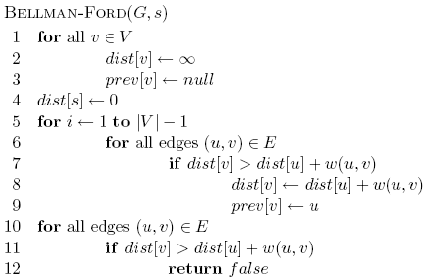
Bellman-Ford algorithm

Slide 133
Bellman-Ford algorithm
Initialize all the distances

Slide 134
Bellman-Ford algorithm
iterate over all edges/vertices and apply update rule

Slide 135
Bellman-Ford algorithm

Slide 136
Bellman-Ford algorithm
check for negative cycles

Slide 137
Bellman-Ford Algorithm
Running time = O(VxE)

Slide 138
Exercise: Negative cycles
What is the shortest path from a to e?
1
1
B
D
A
5
10
-10
C
E
3

Slide 139
Example: Bellman-Ford algorithm
1
3
2
5
-10
4
3
2
Edges: (3,2) (4,3) (1,4) (1,2)
Need to relax |V|-1 = 3 times

Slide 140
Example: Bellman-Ford algorithm
0
∞
1
3
2
RELAX
3 times
5
-10
∞
∞
4
3
2
Edges: (3,2) (4,3) (1,4) (1,2)

Slide 141
Example: Bellman-Ford algorithm
0
∞
1
3
2
RELAX
1 of 3
5
-10
∞
∞
4
3
2
Edges: (3,2) (4,3) (1,4) (1,2)

Slide 142
Example: Bellman-Ford algorithm
0
∞
1
3
2
RELAX
1 of 3
5
-10
∞
∞
4
3
2
Edges: (3,2) (4,3) (1,4) (1,2)

Slide 143
Example: Bellman-Ford algorithm
0
∞
1
3
2
RELAX
1 of 3
5
-10
5
∞
4
3
2
Edges: (3,2) (4,3) (1,4) (1,2)

Slide 144
Example: Bellman-Ford algorithm
0
3
1
3
2
RELAX
1 of 3
5
-10
5
∞
4
3
2
Edges: (3,2) (4,3) (1,4) (1,2)

Slide 145
Example: Bellman-Ford algorithm
0
3
1
3
2
RELAX
2 of 3
5
-10
5
∞
4
3
2
Edges: (3,2) (4,3) (1,4) (1,2)

Slide 146
Example: Bellman-Ford algorithm
0
3
1
3
2
RELAX
2 of 3
5
-10
5
7
4
3
2
Edges: (3,2) (4,3) (1,4) (1,2)

Slide 147
Example: Bellman-Ford algorithm
0
3
1
3
2
RELAX
2 of 3
5
-10
5
7
4
3
2
Edges: (3,2) (4,3) (1,4) (1,2)

Slide 148
Example: Bellman-Ford algorithm
0
3
1
3
2
RELAX
2 of 3
5
-10
5
7
4
3
2
Edges: (3,2) (4,3) (1,4) (1,2)

Slide 149
Example: Bellman-Ford algorithm
0
-3
1
3
2
RELAX
3 of 3
5
-10
5
7
4
3
2
Edges: (3,2) (4,3) (1,4) (1,2)

Slide 150
Example: Bellman-Ford algorithm
0
-3
1
3
2
RELAX
3 of 3
5
-10
5
7
4
3
2
Edges: (3,2) (4,3) (1,4) (1,2)

Slide 151
Example: Bellman-Ford algorithm
0
-3
1
3
2
RELAX
3 of 3
5
-10
5
7
4
3
2
Edges: (3,2) (4,3) (1,4) (1,2)

Slide 152
Example: Bellman-Ford algorithm
0
-3
1
3
2
RELAX
3 of 3
5
-10
5
7
4
3
2
Edges: (3,2) (4,3) (1,4) (1,2)

Slide 153
Example: Bellman-Ford algorithm
0
-3
1
3
2
5
-10
5
7
4
3
2

Slide 154
Bellman-Ford algorithm
Exercise

Slide 155
Bellman-Ford algorithm
10
How many edges is the shortest path from s to:
S
A
8
1
G
-4
B
A:
2
1
1
-2
C
F
-1
3
E
D
-1

Slide 156
Bellman-Ford algorithm
10
How many edges is the shortest path from s to:
S
A
8
1
G
-4
B
A:
3
2
1
1
-2
C
F
-1
3
E
D
-1

Slide 157
Bellman-Ford algorithm
10
How many edges is the shortest path from s to:
S
A
8
1
G
-4
B
A:
3
2
1
1
-2
B:
F
C
-1
3
E
D
-1

Slide 158
Bellman-Ford algorithm
10
How many edges is the shortest path from s to:
S
A
8
1
G
-4
B
A:
3
2
1
1
-2
B:
5
F
C
-1
3
E
D
-1

Slide 159
Bellman-Ford algorithm
10
How many edges is the shortest path from s to:
S
A
8
1
G
-4
B
A:
3
2
1
1
-2
B:
5
F
C
-1
3
E
D
D:
-1

Slide 160
Bellman-Ford algorithm
10
How many edges is the shortest path from s to:
S
A
8
1
G
-4
B
A:
3
2
1
1
-2
B:
5
F
C
-1
3
E
D
D:
7
-1

Slide 161
Bellman-Ford Algorithm
Example

Slide 162
Bellman-Ford algorithm
0
∞
10
S
A
Iteration: 0
8
1
∞
∞
G
-4
B
2
1
1
-2
C
∞
F
∞
-1
3
E
D
-1
∞
∞

Slide 163
Bellman-Ford algorithm
0
10
10
S
A
Iteration: 1
8
1
∞
8
G
-4
B
2
1
1
-2
C
∞
F
∞
-1
3
E
D
-1
∞
∞

Slide 164
Bellman-Ford algorithm
0
10
10
S
A
Iteration: 2
8
1
∞
8
G
-4
B
2
1
1
-2
C
∞
F
9
-1
3
E
D
-1
12
∞

Slide 165
Bellman-Ford algorithm
0
5
10
S
A
Iteration: 3
8
1
10
8
G
-4
B
A has the correct distance and path
2
1
1
-2
C
∞
F
9
-1
3
E
D
-1
8
∞

Slide 166
Bellman-Ford algorithm
0
5
10
S
A
Iteration: 4
8
1
6
8
G
-4
B
2
1
1
-2
C
11
F
9
-1
3
E
D
-1
7
∞

Slide 167
Bellman-Ford algorithm
0
5
10
S
A
Iteration: 5
8
1
5
8
G
-4
B
B has the correct distance and path
2
1
1
-2
C
7
F
9
-1
3
E
D
-1
7
14

Slide 168
Bellman-Ford algorithm
0
5
10
S
A
Iteration: 6
8
1
5
8
G
-4
B
2
1
1
-2
C
6
F
9
-1
3
E
D
-1
7
10

Slide 169
Bellman-Ford algorithm
0
5
10
S
A
Iteration: 7
8
1
5
8
G
-4
B
D (and all other nodes) have the correct distance and path
2
1
1
-2
C
6
F
9
-1
3
E
D
-1
7
9

Slide 170
Bellman-Ford Algorithm
Example:
Negative cycles

Slide 171
Bellman-Ford: Negative cycles
1
4
2
RELAX
3 times
5
5
-10
4
3
3
Edges: (3,2)(4,3)(1,4)(1,2)(2,4)

Slide 172
Bellman-Ford: Negative cycles
0
∞
1
4
2
RELAX
3 times
5
5
-10
∞
∞
4
3
3
Edges: (3,2)(4,3)(1,4)(1,2)(2,4)

Slide 173
Bellman-Ford: Negative cycles
0
∞
1
4
2
RELAX
1 of 3
5
5
-10
∞
∞
4
3
3
Edges: (3,2)(4,3)(1,4)(1,2)(2,4)

Slide 174
Bellman-Ford: Negative cycles
0
∞
1
4
2
RELAX
1 of 3
5
5
-10
∞
∞
4
3
3
Edges: (3,2)(4,3)(1,4)(1,2)(2,4)

Slide 175
Bellman-Ford: Negative cycles
0
∞
1
4
2
RELAX
1 of 3
5
5
-10
5
∞
4
3
3
Edges: (3,2)(4,3)(1,4)(1,2)(2,4)

Slide 176
Bellman-Ford: Negative cycles
0
4
1
4
2
RELAX
1 of 3
5
5
-10
5
∞
4
3
3
Edges: (3,2)(4,3)(1,4)(1,2)(2,4)

Slide 177
Bellman-Ford: Negative cycles
0
4
1
4
2
RELAX
1 of 3
5
5
-10
5
∞
4
3
3
Edges: (3,2)(4,3)(1,4)(1,2)(2,4)

Slide 178
Bellman-Ford: Negative cycles
0
4
1
4
2
RELAX
2 of 3
5
5
-10
5
∞
4
3
3
Edges: (3,2)(4,3)(1,4)(1,2)(2,4)

Slide 179
Bellman-Ford: Negative cycles
0
4
1
4
2
RELAX
2 of 3
5
5
-10
5
8
4
3
3
Edges: (3,2)(4,3)(1,4)(1,2)(2,4)

Slide 180
Bellman-Ford: Negative cycles
0
4
1
4
2
RELAX
2 of 3
5
5
-10
5
8
4
3
3
Edges: (3,2)(4,3)(1,4)(1,2)(2,4)

Slide 181
Bellman-Ford: Negative cycles
0
4
1
4
2
RELAX
2 of 3
5
5
-10
5
8
4
3
3
Edges: (3,2)(4,3)(1,4)(1,2)(2,4)

Slide 182
Bellman-Ford: Negative cycles
0
4
1
4
2
RELAX
3 of 3
5
5
-10
5
8
4
3
3
Edges: (3,2)(4,3)(1,4)(1,2)(2,4)

Slide 183
Bellman-Ford: Negative cycles
0
-2
1
4
2
RELAX
3 of 3
5
5
-10
5
8
4
3
3
Edges: (3,2)(4,3)(1,4)(1,2)(2,4)

Slide 184
Bellman-Ford: Negative cycles
0
-2
1
4
2
RELAX
3 of 3
5
5
-10
5
8
4
3
3
Edges: (3,2)(4,3)(1,4)(1,2)(2,4)

Slide 185
Bellman-Ford: Negative cycles
0
-2
1
4
2
RELAX
3 of 3
5
5
-10
5
8
4
3
3
Edges: (3,2)(4,3)(1,4)(1,2)(2,4)

Slide 186
Bellman-Ford: Negative cycles
0
-2
1
4
2
RELAX
3 of 3
5
5
-10
5
8
4
3
3
Edges: (3,2)(4,3)(1,4)(1,2)(2,4)

Slide 187
Bellman-Ford: Negative cycles
0
-2
1
4
2
RELAX
3 of 3
5
5
-10
3
8
4
3
3
Edges: (3,2)(4,3)(1,4)(1,2)(2,4)

Slide 188
Bellman-Ford: Negative cycles
0
-2
1
4
2
RELAX
Done!
5
5
-10
3
8
4
3
3

Slide 189
Bellman-Ford: Negative cycles
0
-2
1
4
2
RELAX
One more
5
5
-10
3
8
4
3
3
Edges: (3,2)(4,3)(1,4)(1,2)(2,4)

Slide 190
Bellman-Ford: Negative cycles
0
-2
1
4
2
RELAX
One more
5
5
-10
3
6
4
3
3
Edges: (3,2)(4,3)(1,4)(1,2)(2,4)

Slide 191
Bellman-Ford: Negative cycles
0
-2
1
4
2
RELAX
One more
5
5
-10
3
6
4
3
3
Edges: (3,2)(4,3)(1,4)(1,2)(2,4)

Slide 192
Bellman-Ford: Negative cycles
0
-2
1
4
2
RELAX
One more
5
5
-10
3
6
4
3
3
Edges: (3,2)(4,3)(1,4)(1,2)(2,4)

Slide 193
Bellman-Ford: Negative cycles
0
-2
1
4
2
RELAX
One more
5
5
-10
3
6
4
3
3
Edges: (3,2)(4,3)(1,4)(1,2)(2,4)

Slide 194
Bellman-Ford: Negative cycles
0
-2
1
4
2
RELAX
again
5
5
-10
3
6
4
3
3
= 5 + 3 - 10
= - 2

Slide 195
Correctness of Bellman-Ford
Loop invariant:

Slide 196
Correctness of Bellman-Ford
Loop invariant: After iteration i, all vertices with shortest paths from s of length i edges or less have correct distances

Slide 197
Runtime of Bellman-Ford
O(|V| |E|)

Slide 198
Runtime of Bellman-Ford
Can you modify the algorithm to run faster (in some circumstances)?

Slide 199
The Bellman-Ford Algorithm
What algorithm design technique does Bellman-Ford Algorithm follow?
Dynamic programming …

Slide 200
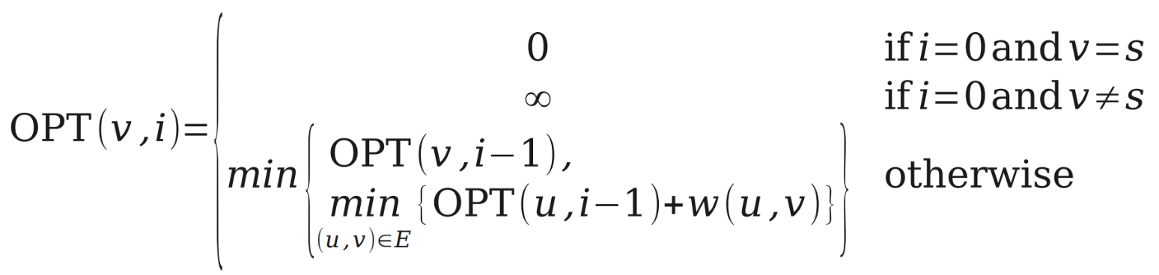
The Bellman-Ford Algorithm
Dynamic programming …

Slide 201
The Recurrence
Idea: Find paths of lengths at most 0, 1, 2, …, n. Let w(u, v) denote the weight of edge (u, v).
Let s be our start node. Let OPT(v, i) be the length of the shortest s – v path whose length is at most i, or ∞ if no path exists.
Claim: OPT(v, i) satisfies the following recurrence:
●
●
●
●

Slide 202
The Bellman-Ford Algorithm
●
The Bellman-Ford algorithm evaluates this recurrence bottom-up:
Create a table DP of size n × n. Set DP[v][0] = ∞ for all v ≠ s.
Set DP[s][0] = 0
For i = 1 to n – 1, for all v ∈ V:
– Set DP[v][i] = min {
DP[v][i – 1],
min { DP[u][i – 1] + w(u, v) } (where (u, v) ∈ E)
}
Return row n of DP.
●
●
●
●
●

Slide 203
_{v₁} -3
v₂
-1
2
1
1 _{v₄}
v₃

Slide 204
_{v₁} -3
v₂
-1
2
1
1 _{v₄}
v₃

Slide 205
_{v₁} -3
 | v₁ | v₂ | v₃ | v₄
3
2
1
0
v₂
-1
2
1
1 _{v₄}
v₃

Slide 206
 | v₁ | v₂ | v₃ | v₄
3
2
1
0
_{v₁} -3
v₂
-1
2
1
1 _{v₄}
v₃

Slide 207
 | v₁ | v₂ | v₃ | v₄
3
2
1
0 | 0 | ∞ | ∞ | ∞
_{v₁} -3
v₂
-1
2
1
1 _{v₄}
v₃

Slide 208
 | v₁ | v₂ | v₃ | v₄
3
2
1
0 | 0 | ∞ | ∞ | ∞
_{v₁} -3
v₂
-1
2
1
1 _{v₄}
v₃

Slide 209
 | v₁ | v₂ | v₃ | v₄
3
2
1 | 0
0 | 0 | ∞ | ∞ | ∞
_{v₁} -3
v₂
-1
2
1
1 _{v₄}
v₃

Slide 210
 | v₁ | v₂ | v₃ | v₄
3
2
1 | 0 | -3
0 | 0 | ∞ | ∞ | ∞
_{v₁} -3
v₂
-1
2
1
1 _{v₄}
v₃

Slide 211
 | v₁ | v₂ | v₃ | v₄
3
2
1 | 0 | -3 | 2
0 | 0 | ∞ | ∞ | ∞
_{v₁} -3
v₂
-1
2
1
1 _{v₄}
v₃

Slide 212
 | v₁ | v₂ | v₃ | v₄
3
2
1 | 0 | -3 | 2 | ∞
0 | 0 | ∞ | ∞ | ∞
_{v₁} -3
v₂
-1
2
1
1 _{v₄}
v₃

Slide 213
 | v₁ | v₂ | v₃ | v₄
3
2
1 | 0 | -3 | 2 | ∞
0 | 0 | ∞ | ∞ | ∞
_{v₁} -3
v₂
-1
2
1
1 _{v₄}
v₃

Slide 214
 | v₁ | v₂ | v₃ | v₄
3
2 | 0
1 | 0 | -3 | 2 | ∞
0 | 0 | ∞ | ∞ | ∞
_{v₁} -3
v₂
-1
2
1
1 _{v₄}
v₃

Slide 215
 | v₁ | v₂ | v₃ | v₄
3
2 | 0 | -3
1 | 0 | -3 | 2 | ∞
0 | 0 | ∞ | ∞ | ∞
_{v₁} -3
v₂
-1
2
1
1 _{v₄}
v₃

Slide 216
 | v₁ | v₂ | v₃ | v₄
3
2 | 0 | -3 | 2
1 | 0 | -3 | 2 | ∞
0 | 0 | ∞ | ∞ | ∞
_{v₁} -3
v₂
-1
2
1
1 _{v₄}
v₃

Slide 217
 | v₁ | v₂ | v₃ | v₄
3
2 | 0 | -3 | 2 | -2
1 | 0 | -3 | 2 | ∞
0 | 0 | ∞ | ∞ | ∞
_{v₁} -3
v₂
-1
2
1
1 _{v₄}
v₃

Slide 218
 | v₁ | v₂ | v₃ | v₄
3
2 | 0 | -3 | 2 | -2
1 | 0 | -3 | 2 | ∞
0 | 0 | ∞ | ∞ | ∞
_{v₁} -3
v₂
-1
2
1
1 _{v₄}
v₃

Slide 219
 | v₁ | v₂ | v₃ | v₄
3 | 0
2 | 0 | -3 | 2 | -2
1 | 0 | -3 | 2 | ∞
0 | 0 | ∞ | ∞ | ∞
_{v₁} -3
v₂
-1
2
1
1 _{v₄}
v₃

Slide 220
 | v₁ | v₂ | v₃ | v₄
3 | 0 | -3
2 | 0 | -3 | 2 | -2
1 | 0 | -3 | 2 | ∞
0 | 0 | ∞ | ∞ | ∞
_{v₁} -3
v₂
-1
2
1
1 _{v₄}
v₃

Slide 221
 | v₁ | v₂ | v₃ | v₄
3 | 0 | -3 | -1
2 | 0 | -3 | 2 | -2
1 | 0 | -3 | 2 | ∞
0 | 0 | ∞ | ∞ | ∞
_{v₁} -3
v₂
-1
2
1
1 _{v₄}
v₃

Slide 222
 | v₁ | v₂ | v₃ | v₄
3 | 0 | -3 | -1 | -2
2 | 0 | -3 | 2 | -2
1 | 0 | -3 | 2 | ∞
0 | 0 | ∞ | ∞ | ∞
_{v₁} -3
v₂
-1
2
1
1 _{v₄}
v₃

Slide 223
Analyzing Time Complexity
●
What is the time complexity of this algorithm?
Create a table DP of size n × n. Set DP[v][0] = ∞ for all v ≠ s.
Set DP[s][0] = 0
For i = 1 to n – 1, for all v ∈ V:
– Set DP[v][i] = min {
DP[v][i – 1],
min { DP[u][i – 1] + w(u, v) } (where (u, v) ∈ E)
}
Return row n of DP.
●
●
●
●
●
●
Answer: O(mn), if you reverse G prior to running the algorithm.

Slide 224
Analyzing Space Complexity
●
What is the space complexity of this algorithm?
Create a table DP of size n × n. Set DP[v][0] = ∞ for all v ≠ s.
Set DP[s][0] = 0
For i = 1 to n – 1, for all v ∈ V:
– Set DP[v][i] = min {
DP[v][i – 1],
min { DP[u][i – 1] + w(u, v) } (where (u, v) ∈ E)
}
Return row n of DP.
●
●
●
●
●
●
Answer: O(n²). (Can we reduce this?)

Slide 225
Shortest Paths in DAGs
  Topologically sort vertices in G;
  Initialize(G, s);
  for each u in V[G] (in order)
  do
  for each v in Adj[u]
  do
  Relax(u, v, w)
  od
  od

Slide 226
Example
6
1
r
s
t
u
v
w
∞
5
0
2
∞
7
∞
–1
∞
–2
∞
4
3
2

Slide 227
Example
6
1
r
s
t
u
v
w
∞
5
0
2
∞
7
∞
–1
∞
–2
∞
4
3
2

Slide 228
Example
6
1
r
s
t
u
v
w
∞
5
0
2
2
7
6
–1
∞
–2
∞
4
3
2

Slide 229
Example
6
1
r
s
t
u
v
w
∞
5
0
2
2
7
6
–1
6
–2
4
4
3
2

Slide 230
Example
6
1
r
s
t
u
v
w
∞
5
0
2
2
7
6
–1
5
–2
4
4
3
2

Slide 231
Example
6
1
r
s
t
u
v
w
∞
5
0
2
2
7
6
–1
5
–2
3
4
3
2

Slide 232
Example
6
1
r
s
t
u
v
w
∞
5
0
2
2
7
6
–1
5
–2
3
4
3
2

Slide 233
Linear Programming and
Bellman-Ford Algorithm
LINEAR PROGRAMMING(LP)
given: an mxn constraint matrix A & an mx1 bound vector b & an nx1 cost vector c
problem : find an n-vector x that maximizes c^{T}x subject
n
n
A
b
x
m
n
m
maximizing
C
T
x
n

Slide 234
Linear Programming and
Bellman-Ford Algorithm
Linear feasibility:
    satisfy m linear constraints : Σ a_{ij} ≤ b_{i}
    for i = 1,2,...,m
Linear optimization:
    maximize the linear cost(objective) function: Σ λϕξϕ
General algorithms:
    simplex: practical, but worst-case is exponential
    ellipsoid: theoretical, polynomial time
    Karmarkar: polynomial time, practical
ν
ι = 1
ν
ι = 1

Slide 235
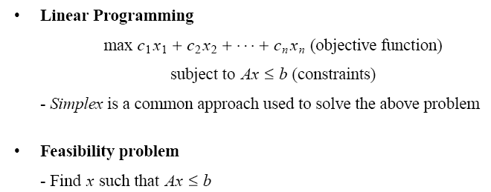
Application: Feasibility Problem

Slide 236
Application: Feasibility Problem (cont.)

Slide 237
Application: Feasibility Problem (cont.)

Slide 238

Application: Feasibility Problem (cont.)
-1
x₁
0
x₂
5
0
4
0
x₀
0
1
x₃
0
-1
0
-3
x₅
x₄
-3

Slide 239
Application: Feasibility Problem (cont.)
0
-1
X₁
0
0
X₂
0
5
4
0
0
X₀
0
X₃
0
1
-1
-3
0
X₄
0
0
-3
X₅

Slide 240
Application: Feasibility Problem (cont.)
0
-1
X₁
0
0
X₂
0
5
4
0
0
X₀
0
X₃
0
1
-1
-3
0
X₄
0
0
-3
X₅

Slide 241
Application: Feasibility Problem (cont.)
0
-1
X₁
0
0
X₂
0
5
4
0
0
X₀
0
X₃
0
1
-1
-3
0
X₄
0
0
-3
X₅

Slide 242
Application: Feasibility Problem (cont.)
0
-1
X₁
0
0
X₂
0
5
4
0
0
X₀
0
X₃
0
1
-1
-3
0
X₄
-1
-3
-3
X₅

Slide 243
Application: Feasibility Problem (cont.)
0
-1
X₁
0
0
X₂
0
5
4
0
0
X₀
0
X₃
0
1
-1
-3
0
X₄
-1
-4
-3
X₅

Slide 244
Application: Feasibility Problem (cont.)
-5
-1
X₁
0
-3
X₂
0
5
4
0
0
X₀
0
X₃
0
1
-1
-3
0
X₄
-1
-4
-3
X₅

Slide 245
Application: Feasibility Problem (cont.)
Size of the constraint graph
If we have m constraints with n unknowns
(Ax ≤ b, A is m x n)
V = n + 1 and E = m + n
Running time:
O(VE) = O(n + 1) (m + n))
= O(n² + n m)

